Slide 1

REMITTANCE PATTERNS AND ECONOMIC DEVELOPMENT
HDSC SPRING'23
25th August 2023
Team Catboost

Slide 2


TEAM CATBOOST
OTHER ACTIVE MEMBERS
Arundarasi Rajendran
Anih Nathan Chizoba
Adeniyi Olaolu Peter
Akinade Phillip Akintoye
Olalekan Okewale
Ibrahim Abdulsalam Abdullahi
INCREASE CHRISTIAN
Etietop Udofia
Carla Bailón Rosas
Akanbi Abiodun
Kawonise Abdullateef
Joseph Ngota Chilo
Abdulkareem Sikirulahi Opeyemi
Bamiteko Ibiduni Adekemi
Sunday Kingsley
Benjamin Lawani
George Ohikhatemen
PRESENTER 1
PRESENTER 2
Anih Nathan Chizoba
Miracle Uche
Project Lead
Confidence Chinelo Ojiako
Assistant Project Lead
Deya Chatterjee
Query Analyst
Miracle Uche

Slide 3
PROBLEM STATEMENT
Owing to existing research gaps from literature, the project seeks to develop and deploy a model that will predict the GDP and unemployment-rate of a country based on its remittance flow pattern, thereby providing an AI-powered platform that will support forecasting and decision-making by stakeholders.

Slide 4
Previous research
The study of the relationship between remittance inflows and per capita income growth focused on Small Island Developing States (SIDS) using econometric analysis of data for 136 developing countries, including 25 SIDS, for the period 1971 to 2010.
The impact of worker remittances on economic growth of Albania and five regional countries using annual panel data from 1999–2013.
The study conducted by a team of interns at Hamoye AI Lab known as Team Bayes (HDSC WINTER, 2023). The team carried out research on the effect of remittance patterns on economic development.

Slide 5
OUR APPROACH
This project stands out in its approach as it steadily and meticulously:
Prepared the data
Explored and gather hypothesis testing with python library, EDA with python and Power BI
Performed feature engineering
Iterate through
Build machine learning models
Evaluate the models
Ensemble a combination of high performing models
Deploy the best model

Slide 6
DATASET DESCRIPTION
The entire dataset was obtained from the World Bank website. It comprised five separate datasets that were merged to serve the purpose of this study.
Remittance Received: The dataset contain variables such as; country name and remittance inflow to those countries from 1960 to 2022.
Remittance Paid: The dataset contain variables such as country name and remittance outflow from those countries from 1960 to 2022.
Population: The dataset contains country names and population size of those countries from 1960 to 2022.
GDP: The dataset contains country names and GDP of countries from 1960 to 2022.
Unemployment Rate: The dataset contains country names and unemployment rate from 1960 to 2022.
Net-Migration: The dataset contains country names and their net migration from 1960 to 2022. Net migration is the number of immigrants minus the number of emigrants in a country. This value can be negative.

Slide 7
DATA CLEANING AND TRANSFORMATION
Handling missing values: NAN between 1960 and 1969 were dropped
Missing values imputation: Random null values within the remaining years were filled with zeroes
Dropping wrong data: Wrong country names were dropped
Data transformation: The six datasets were melted and merged together

Slide 8
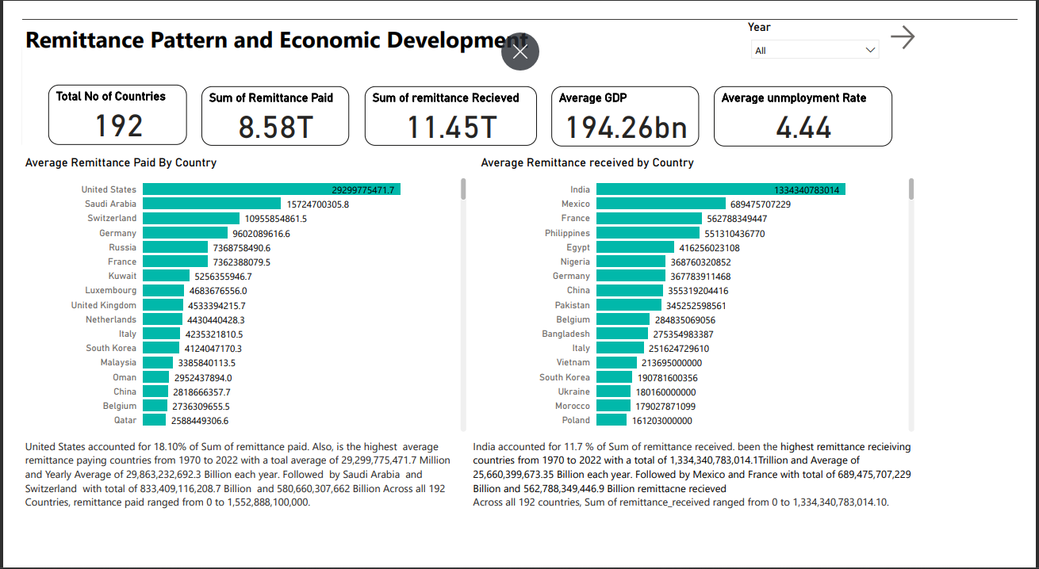
FURTHER VISUALIZATION ON POWER BI
Click here for more

Slide 9
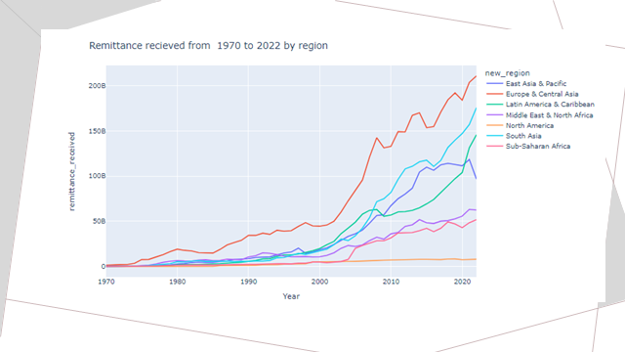

Slide 10
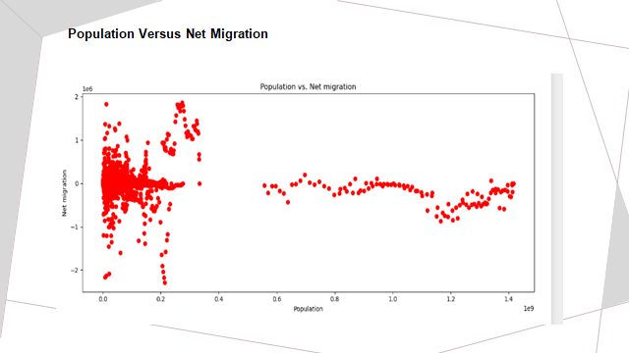

Slide 11
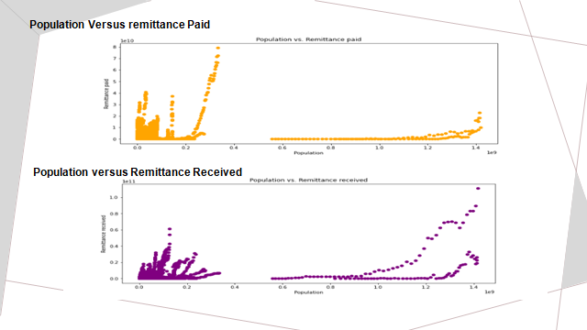

Slide 12
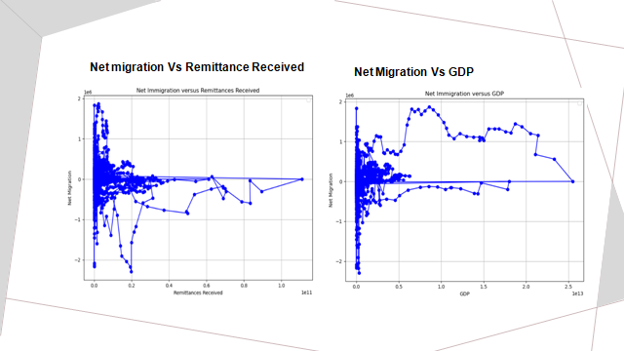

Slide 13
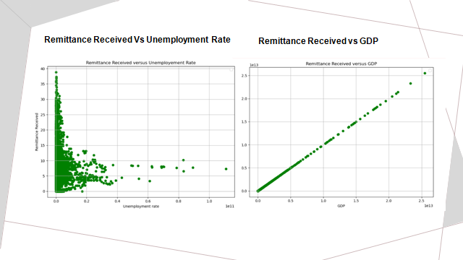

Slide 14
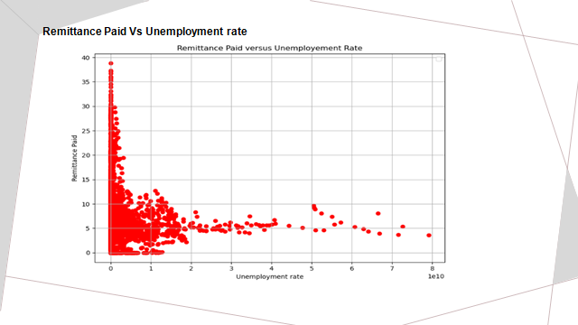

Slide 15
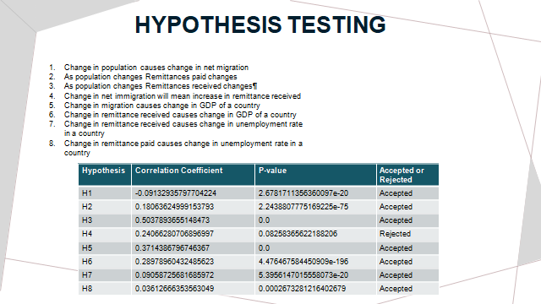

Slide 16
FEATURE ENGINEERING
The following novel features were created to derive more insights on the relationship between remittance patterns and economic development:
Remittance_growth_rate
Remittance_per_capita
Remittance_volatility
Remittance_to_gdp_ratio
Remittance growth rate,
Unemployment rate change.

Slide 17
MODEL PIPELINE
DATA SOURCING
DATA PREPARATION
FEATURE
ENGINEERING
MODEL DEVELOPMENT
MODEL DEPLOYMENT
MODEL EVALUATION

Slide 18
MODEL DEVELOPMENT
Data Cleaning and Preprocessing
Replace infinite values, drop unnecessary columns, working with 0 values.
Exploratory Data Analysis
Histograms, distribution analysis, time serie plot,trend plots.
Working with Categorical and Numerical Columns
Min Max Scaler for numerical columns, Label encoding for categorical columns.
Train - test split (70:30), working with selected variables, Training the regressors :, Random Forest, XGBoost, Support Vector Regressor (SVR) and Stochastic Gradient Descent (SGD) with parameter tuning.
Training the model using various algorithms

Slide 19
MODEL EVALUATION
The Random Forest model surpasses all other models across all evaluation parameters, according to an examination of model performance indicators.
It consistently has the lowest mean squared error (MSE), mean absolute error (MAE), root mean squared error (RMSE), and mean absolute percent error (MAPE), indicating greater predictive accuracy.
Furthermore, the Random Forest model has the highest R-squared (R2) value, indicating that it explains a considerable percentage of the data variance.
As a result of this thorough evaluation, it was clear that the Random Forest model is the most robust and effective option for modelling the data, offering the best overall performance in predicting the target variables.

Slide 20
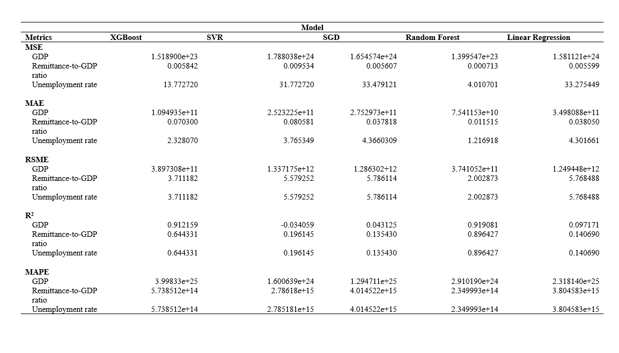

Slide 21
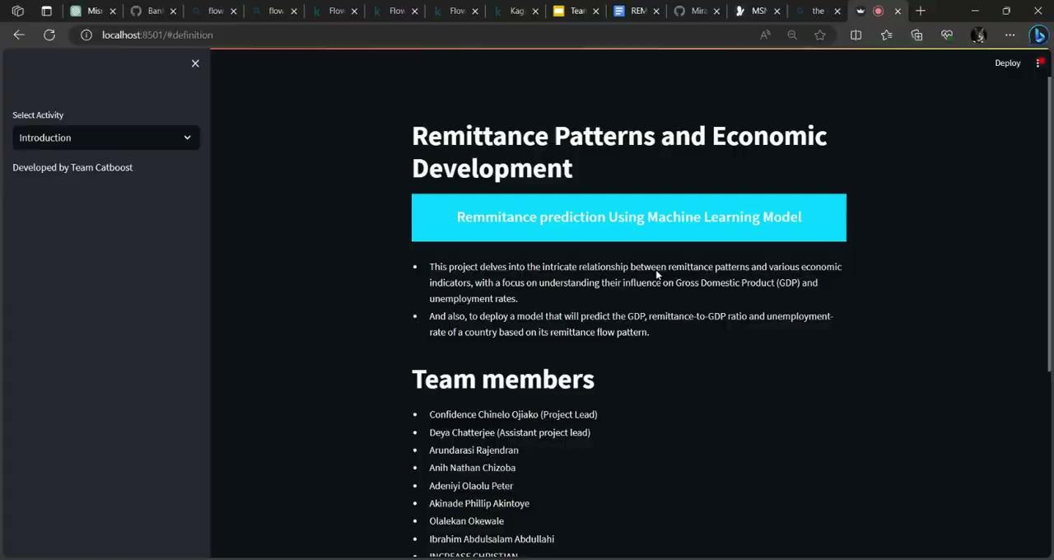
MODEL DEPLOYMENT

Slide 22
SUMMARY
Through meticulous data analysis, including preprocessing and feature engineering, various machine learning models were employed to predict economic indicators like GDP and unemployment rate. The findings showcased the Random Forest model's outstanding accuracy, followed by competitive performances from SVR, linear regression and SGD models.
CHALLENGES
Working with additional datasets from World Bank.
The lack of data about GDP, remittance and other features from 1970 to 1980 in some countries.

Slide 23
RELATED LINKS
Presentation Slides here
This project is hosted on Github
The project is deployed on Sreamlit
Model Development on Github
Exploratory Data Analysis on Github
Hypothesis Testing on GitHub
Documentation and Research paper
The dashboard is deployed on Power Bi

